Slide 1
Comment Anywhere Week 5 Report
Karl Miller Presenting
with Luke Bates and Frank Bedekovich
2/20/2023

Slide 2
Communicating Comments
The data a user needs to see is different from what is optimally stored in the database.
Data transformations are necessary

Slide 3
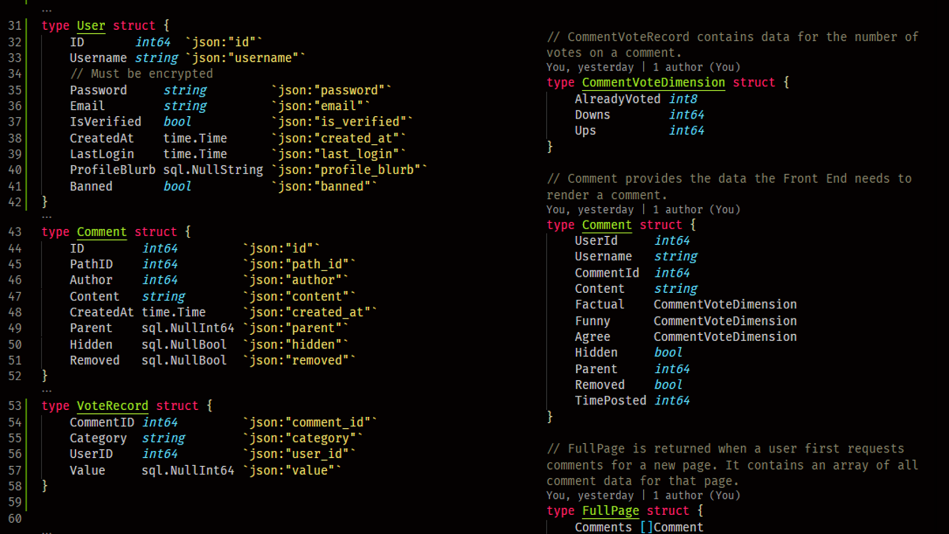
Comment Responses versus Database Data
Database Records
Data sent to Front End

Slide 4
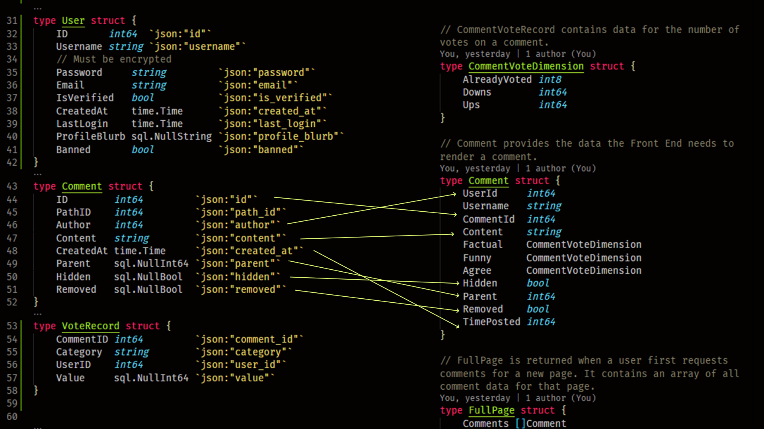
A lot of data maps, but we are missing some fields, like Username!

Slide 5
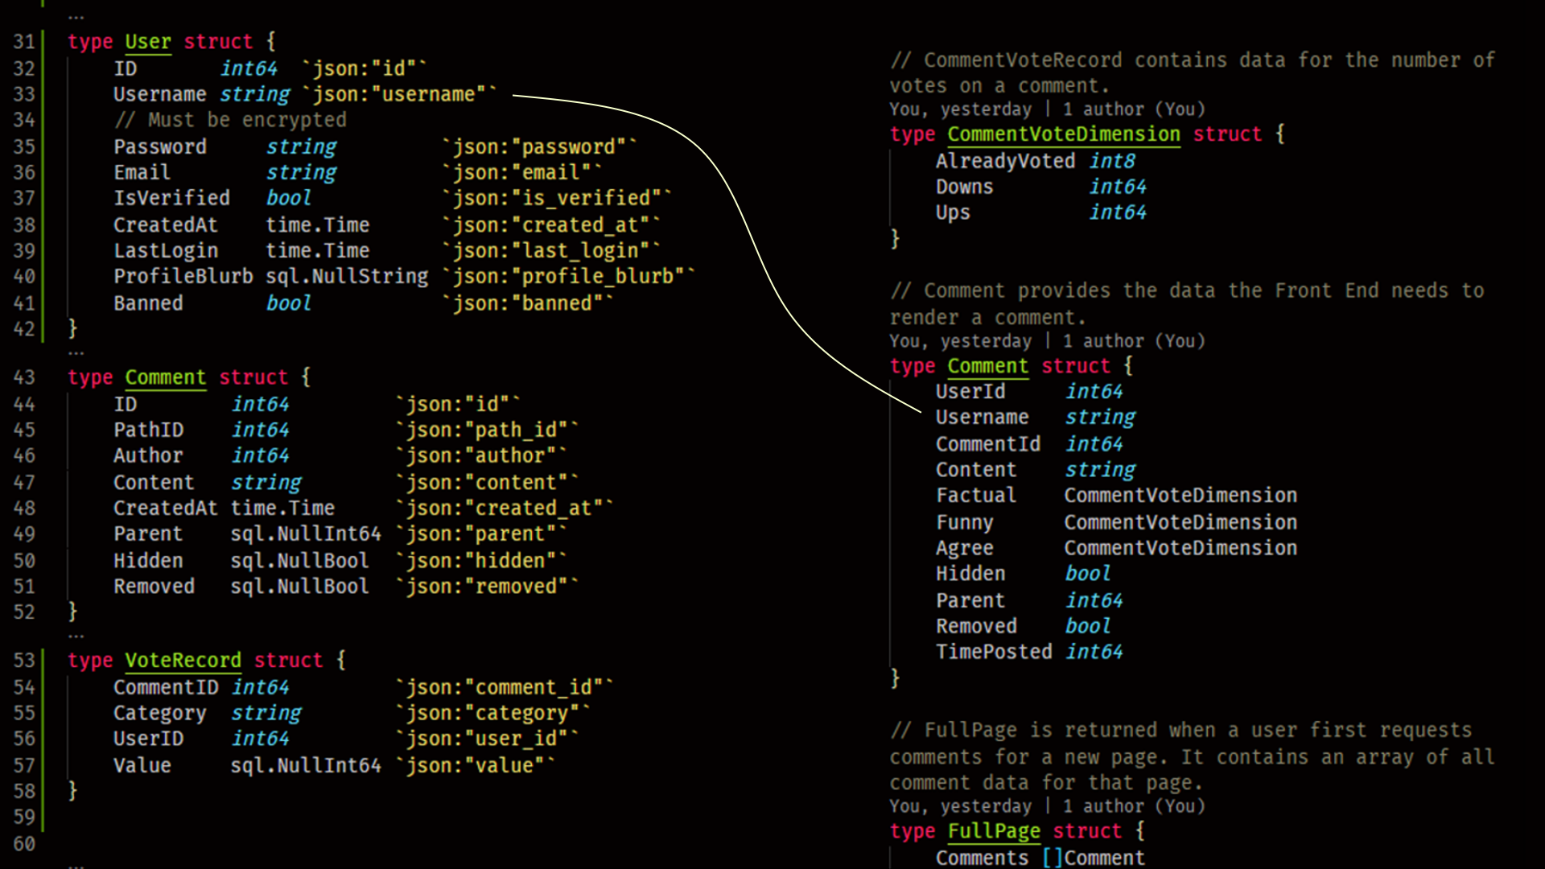
Comment Responses versus Database Data
We will have to query the User’s table to get the username
What about these fields?

Slide 6
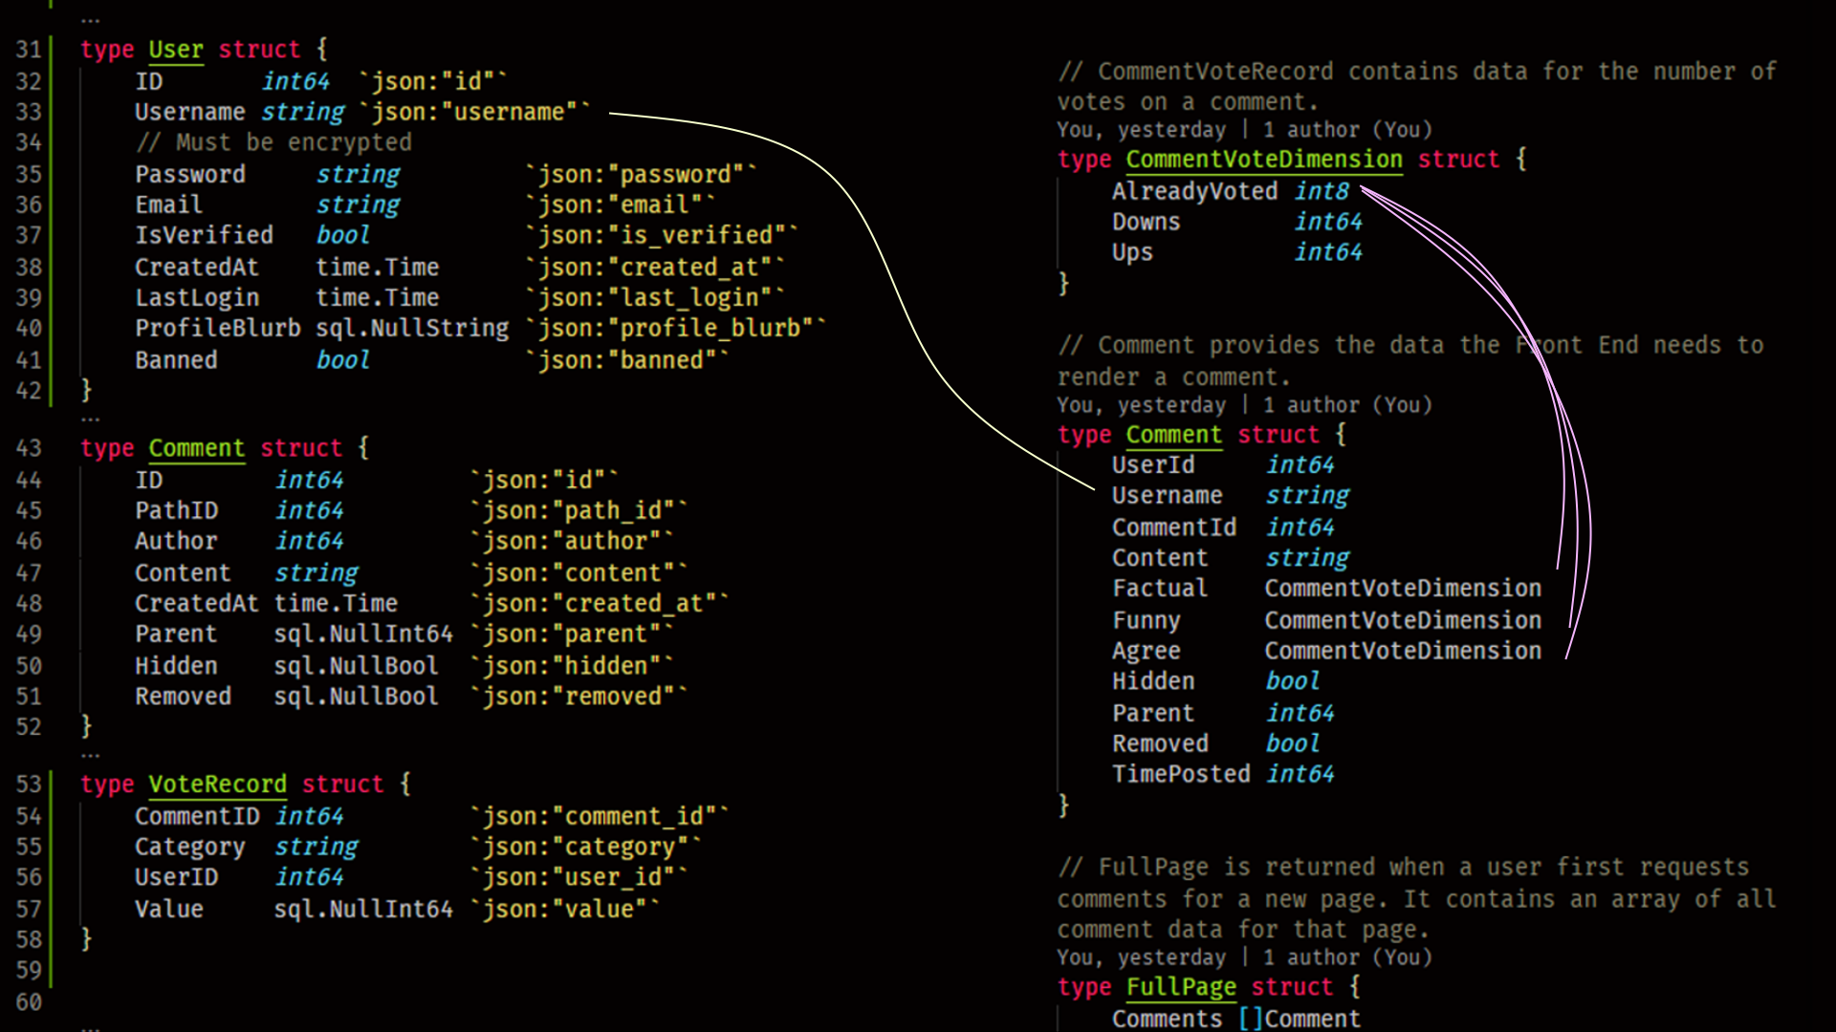
Comment Responses versus Database Data

Slide 7
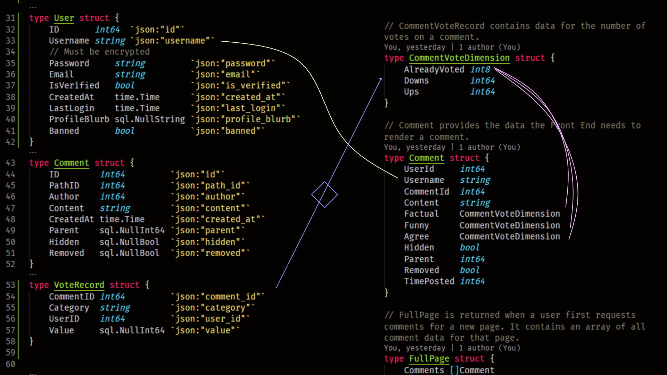
Comment Responses versus Database Data
We actually need aggregate data from the VoteRecords table

Slide 8
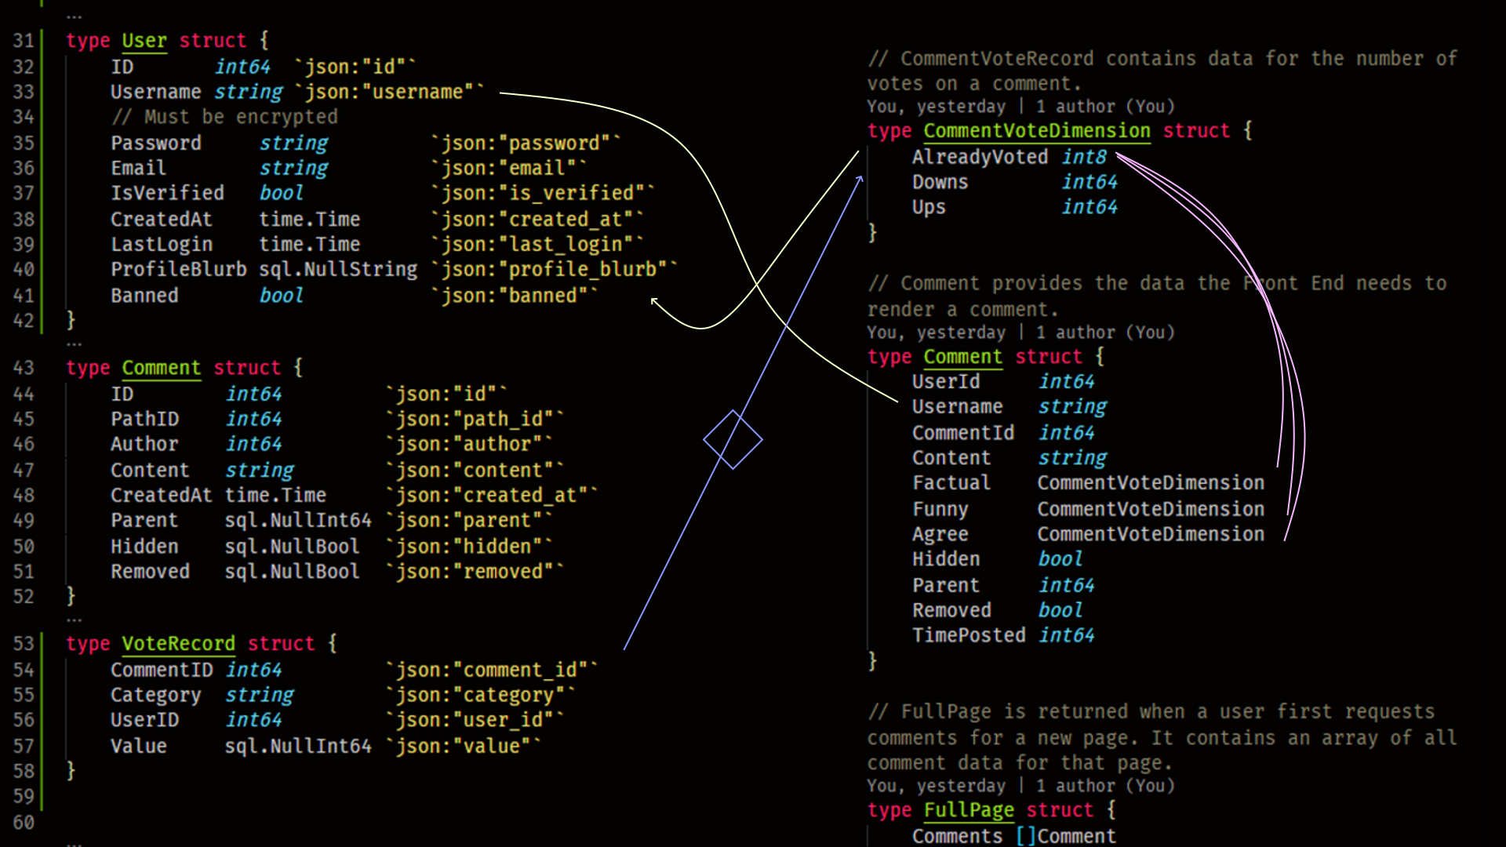
Comment Responses versus Database Data
We also need to check whether the user requesting already voted

Slide 9
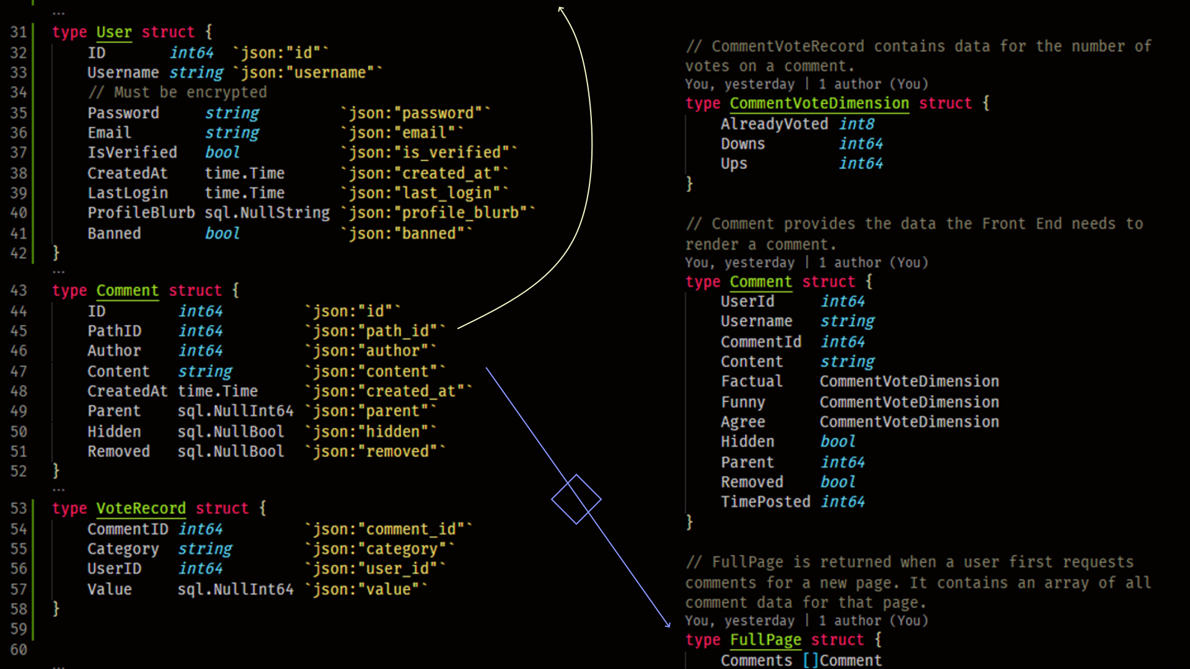
Comment Responses versus Database Data
Comments have to be aggregated and sent in big batches to the client, and matched to a given URL / “Path”

Slide 10
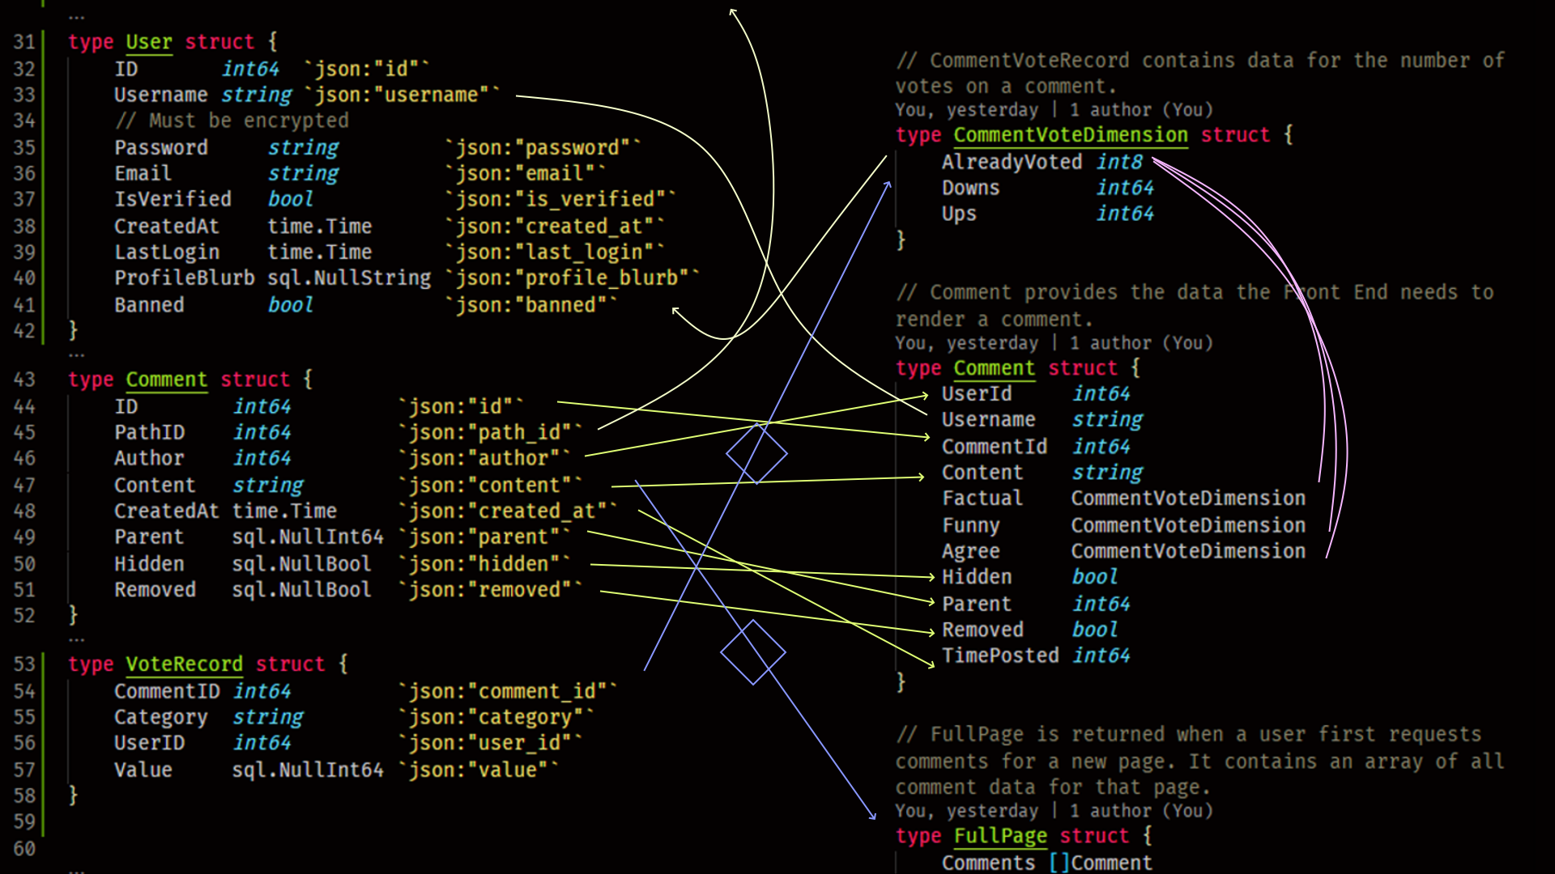
A lot of transformation!

Slide 11
Queries (databases)
Queries are how we request information from the database
They are usually ultimately transmitted as a string, for example,
“SELECT * FROM “Comments” WHERE user_id = 5”;
We are using kyleconroy/sqlc to turn a query like the above into Go Code.
The generated code actually transmits the string to the database, reads the database response, and convert the response into something we can use.
It generates a struct type for every table schema, query return, and query parameters that are more than one item.

Slide 12
Query (generated struct)
Most of the generated code lives in an object called “Queries”
If we have a reference to Server, we have access to Server.DB.Queries.
Queries are defined in the generated module database.generated.
Queries gives us functions like “CreateUser” or “GetCommentsForPath”

Slide 13
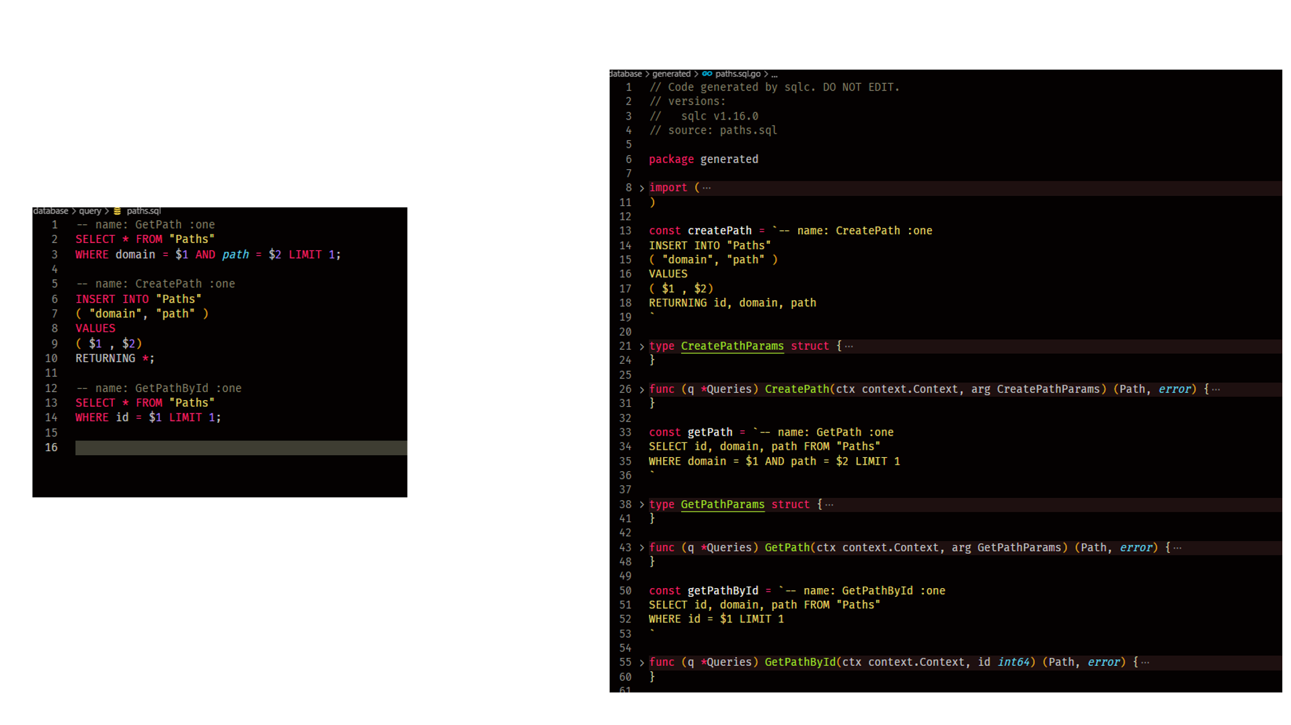
Generating path-related methods

Slide 14
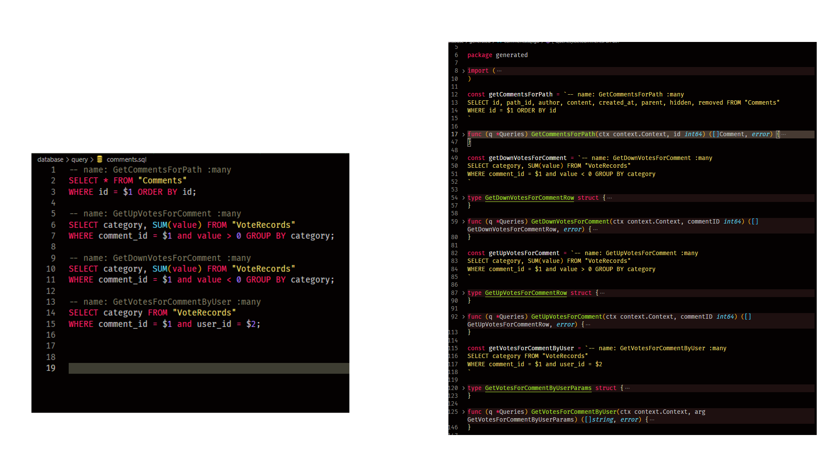
Generating comment-related methods

Slide 15
Wrapping Query with Store
It might take multiple database queries to instantiate something or get communication entities we want.
The comment example previously shown is one such case.
We can wrap multiple calls to generated functions in Queries in our wrapper class, Store.
Store contains the reference to Queries.
If Queries is at Server.DB.Queries, Store is Server.DB.

Slide 16
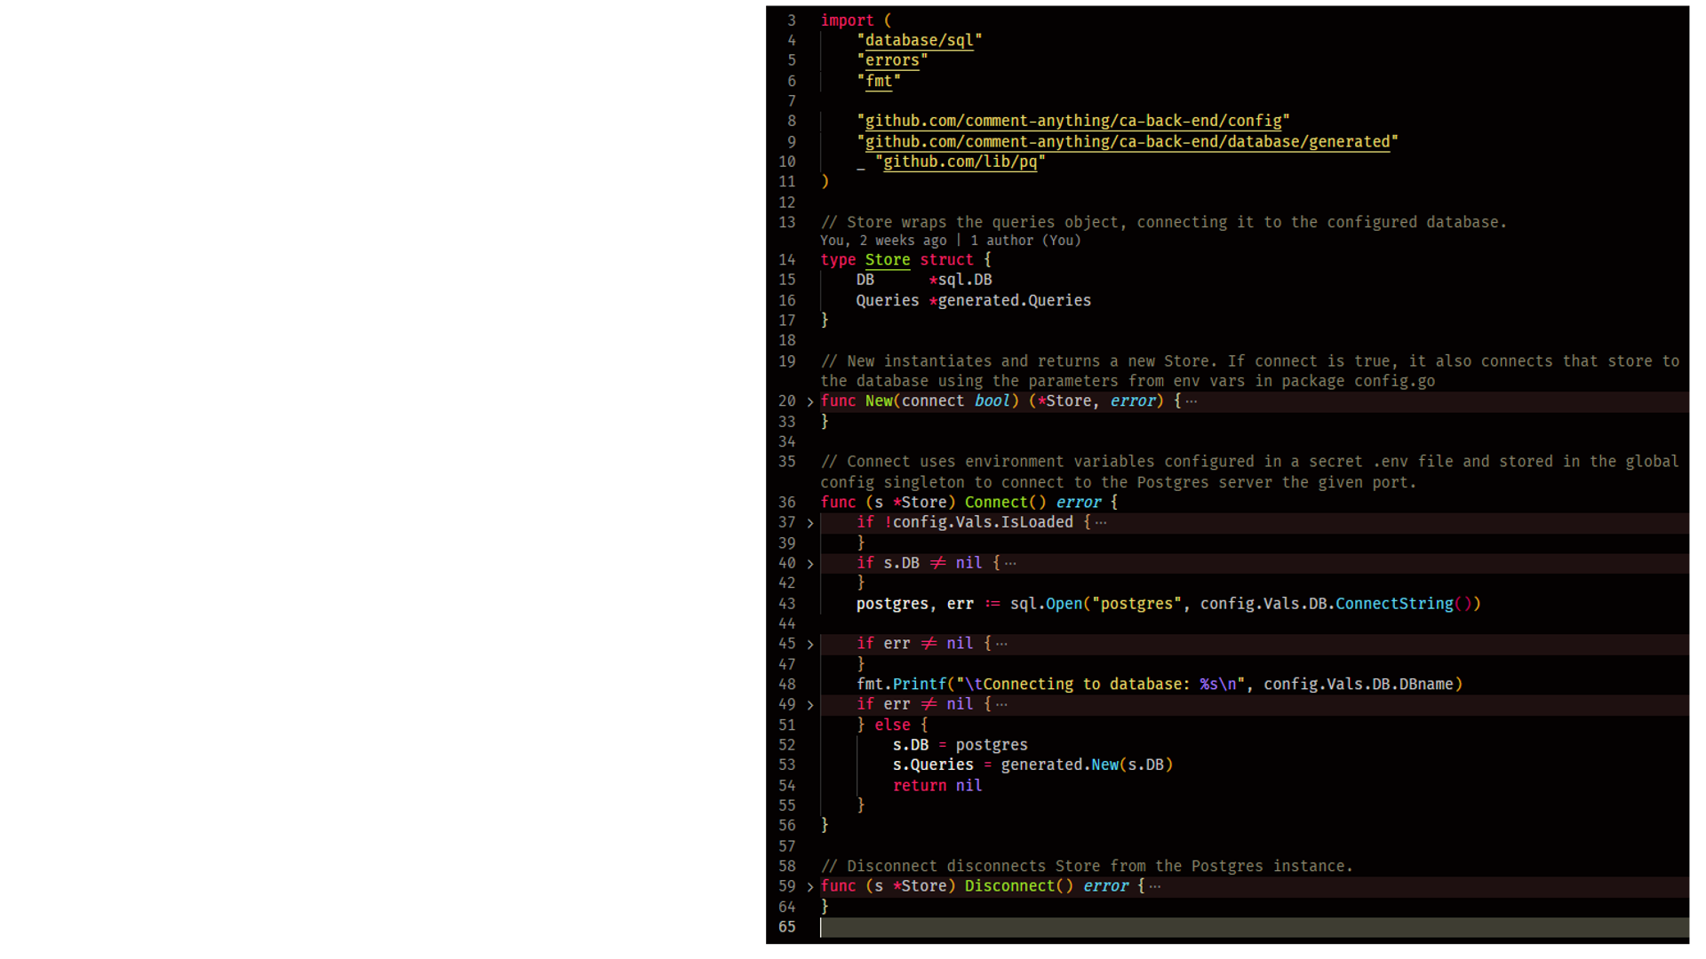
Store
Store has already been responsible for connecting to the database
It holds the generated Queries object reference.

Slide 17
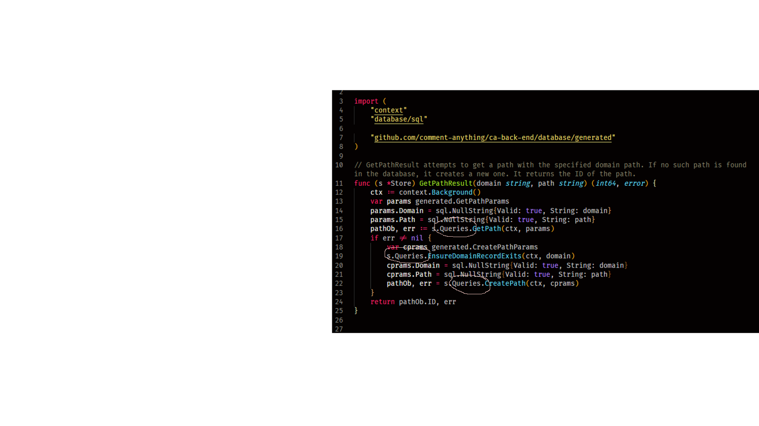
Store
Store Methods may include multiple calls to Query methods.
GetPathResult performs 3 queries to achieve the desired effect.

Slide 18
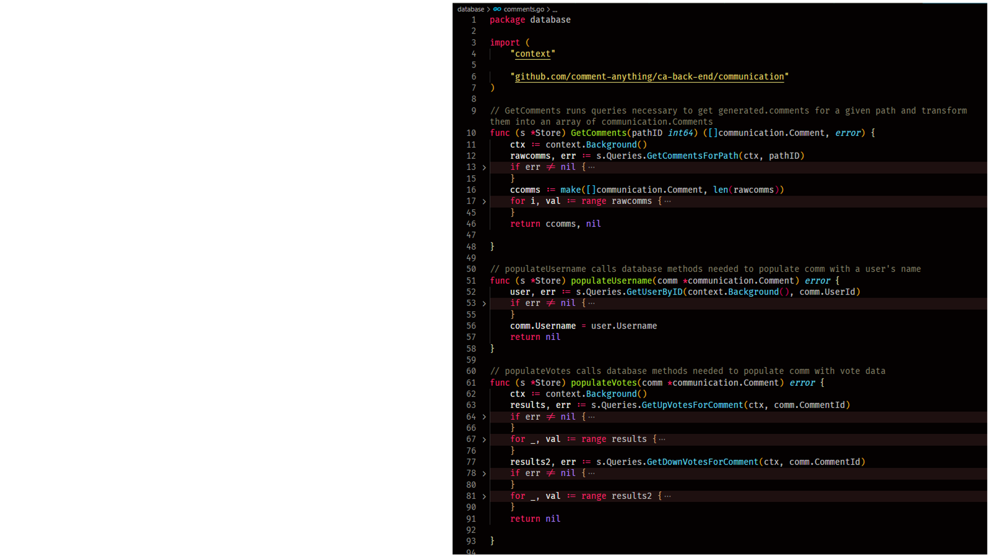
Store
Store.GetComments uses two additional private methods to populate the username and votes on the array of communication.Comment entities it returns, each calling another query.

Slide 19
Caching Comment Data with Page
We don’t need to query the database constantly for data that is being accessed frequently.
We will have a cache of loaded Pages on the back end.
Each has a map for the users currently on that page and the guests currently on the page, so if something changes on the page, everyone there can receive updates next time they talk to the server.
Page keeps a map of comment IDs to loaded server-client communication entities, so it doesn’t have to rebuild comment responses from database queries.

Slide 20
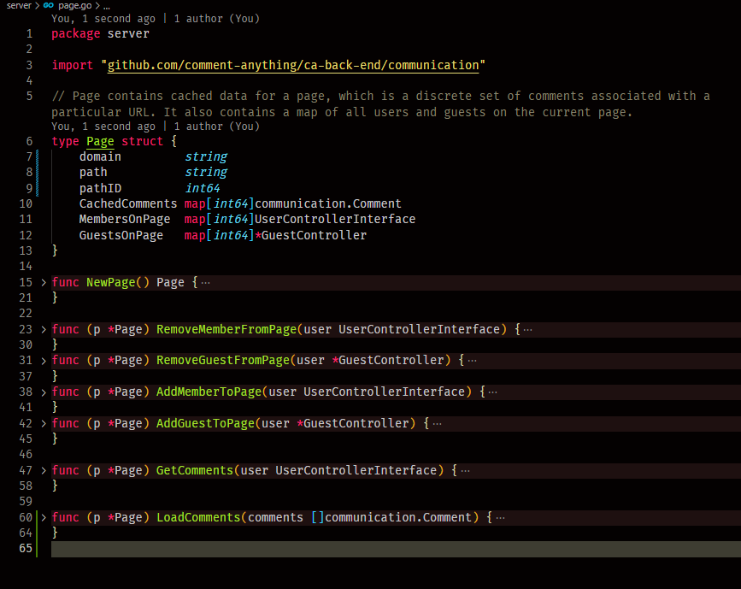
Page
Methods to add and remove members and guests to the page
Methods to load comments
GetComments isn’t actually a Getter; puts the Page’s comments in a user’s next response array
Controllers have a reference to the page they are visiting, or nil if they aren’t on any page.

Slide 21
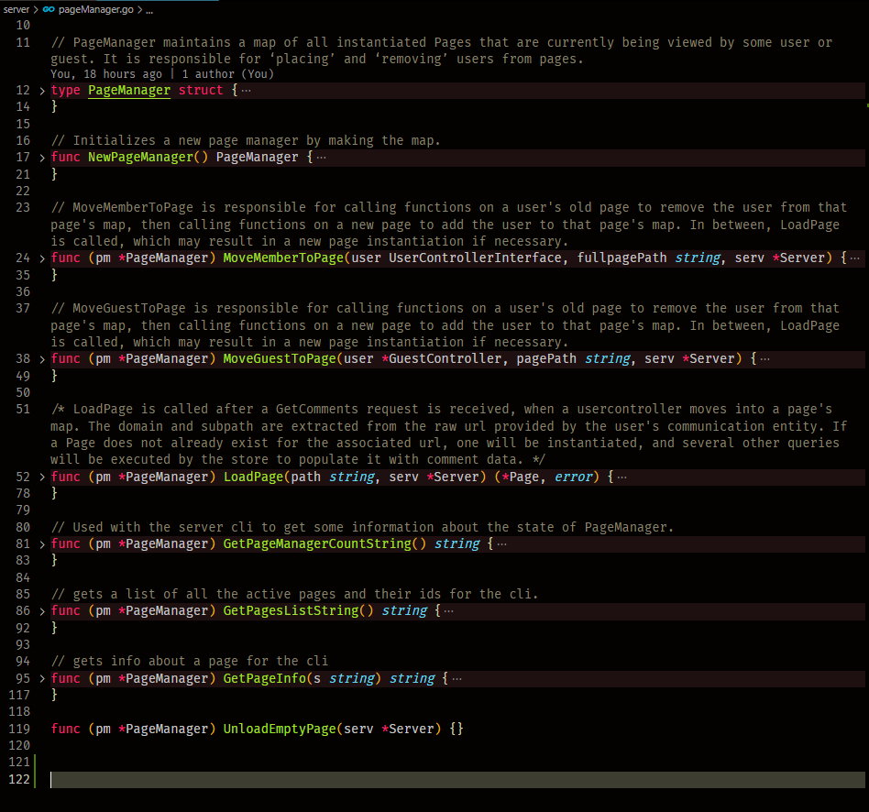
PageManager
Has a map of active pages
Responsible for loading new pages when a user wants comments for a new path.
Responsible for transferring users between pages.

Slide 22
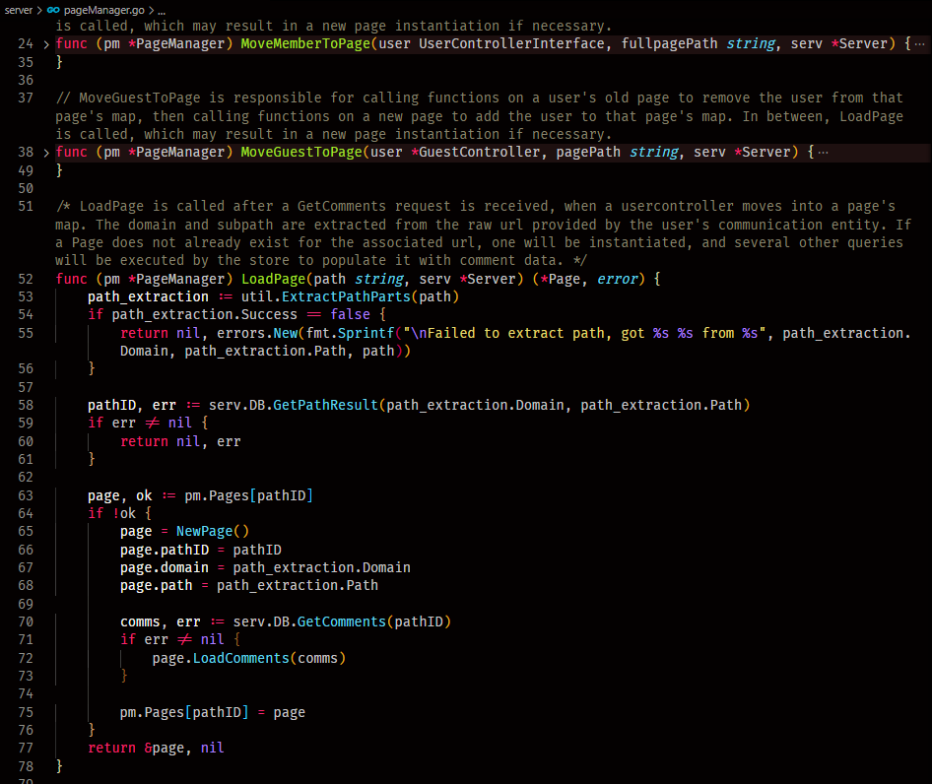
PageManager
When LoadPage is called, PageManager first checks its map of loaded pages
If it already has that page loaded, it can return that
Otherwise it loads a new page and puts it in the map

Slide 23
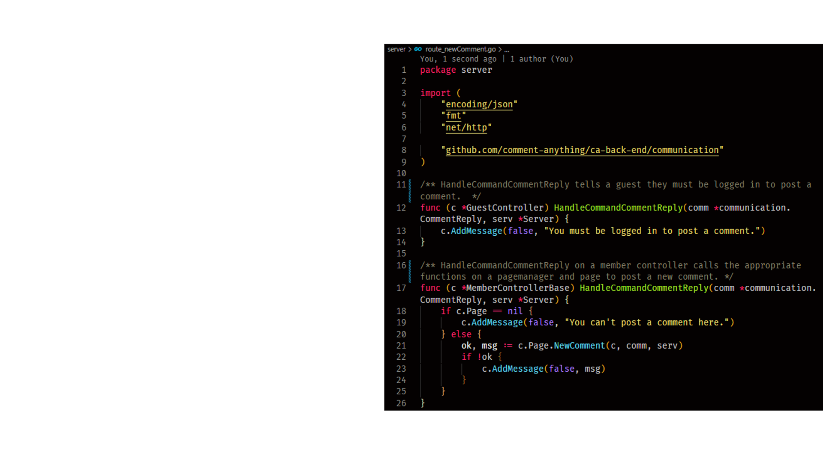
New comments
When a Guest tries to post a comment, they just get an error message.
A member will of course attempt to post the new comment
Polymorphic controllers are working well

Slide 24
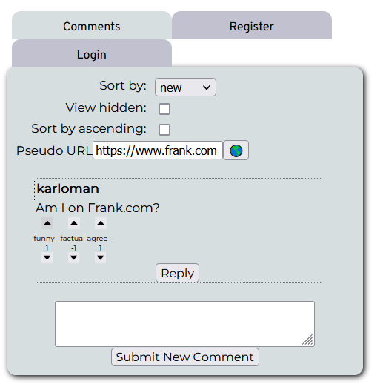
User Interface
We implemented many items needed for the user interface
Pictured is a guest attempting to vote on a comment.

Slide 25
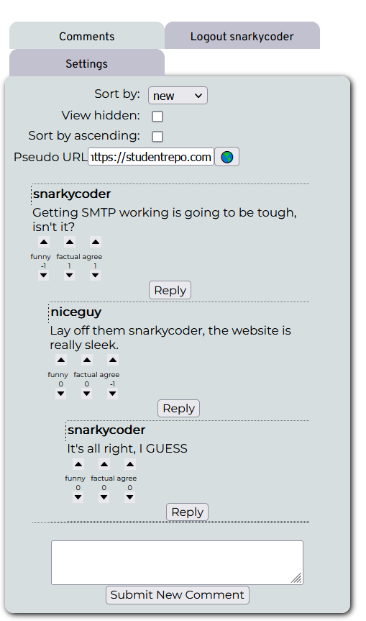
User Interface
Nested comments are supported
Votes are supported

Slide 26
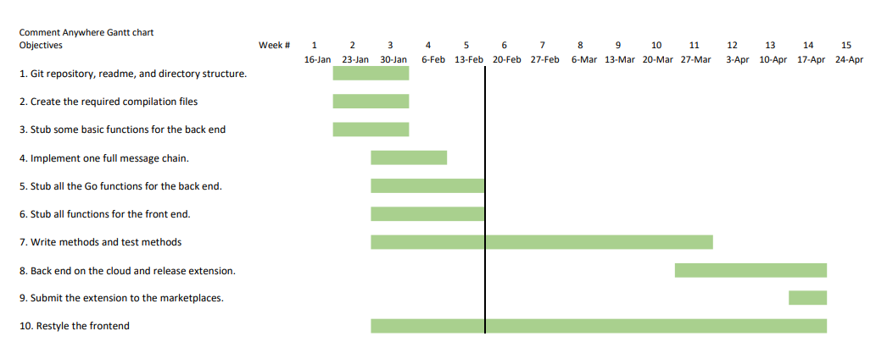
New Gantt Chart
We allocated more time for “Write methods and test methods” and less to cloud deployment.
We need to average 3-4 pipelines per week to meet our target now.

Slide 27
Integration Test 2, Devlog videos
We created a video of integration test 2
I also recorded 4 devlog videos if anyone is curious about my process
See https://comment-anywhere.github.io week 5 update

